Slide 1

Our Grid’s Second Wind:
The effect of increased wind generation on wholesale electricity prices
Michelle Zheng ‘16
Advisor: Anja Sautmann

Slide 2
Research Questions
How have each of the resources on the resource mix historically impacted prices in New England’s electricity markets?
How do increased quantities of wind generation impact prices in New England’s electricity markets? How does this effect vary at different levels of electricity demand and by the composition of the resource mix?
Notes:
My goal is to look at the impact of increased wind generation on prices in electricity markets, using the New England market as an example. To do this, I look at the impact of changes in resource penetrations on prices in historical data from the New England market, and then simulate the effect of increased wind generation on

Slide 3
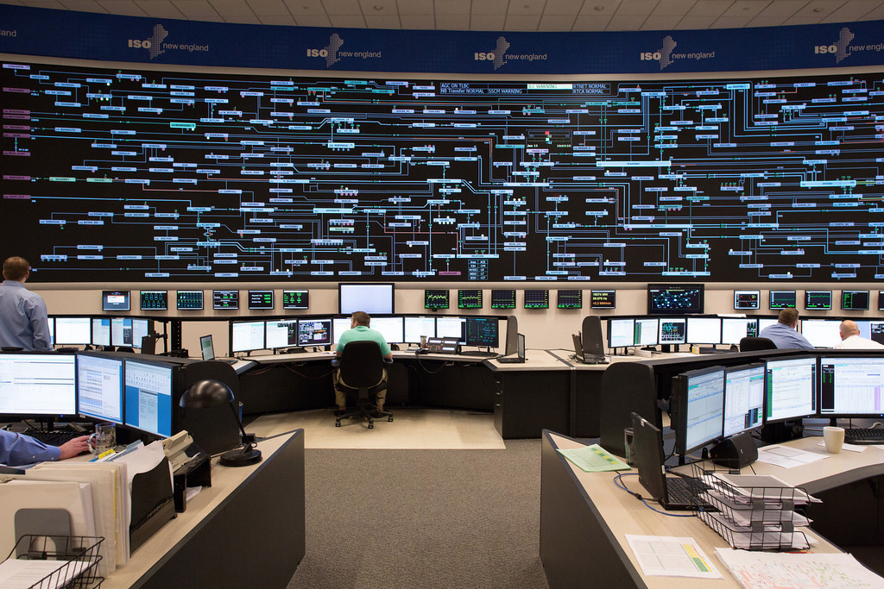

Key Terms:
Independent System Operator
of New England (ISO-NE)
Notes:
The ISO exists to ensure grid reliability, handling the bulk procurement of electricity which is then passed on to customer facing utilities like national grid that distribute to end users.

Slide 4


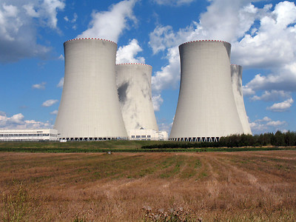
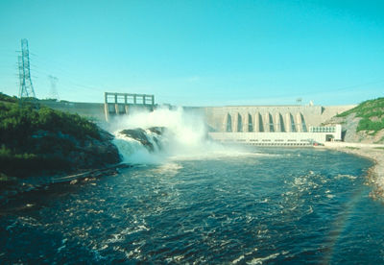




transformers, transmission
Supply
ISO-NE
data
data
Demand
transformers, transmission
Notes:
It runs competitive electricity markets, where many sellers of electricity can bid the prices and quantities at which they can offer electricity to meet demand. By taking in data and often owning transmission lines

Slide 5
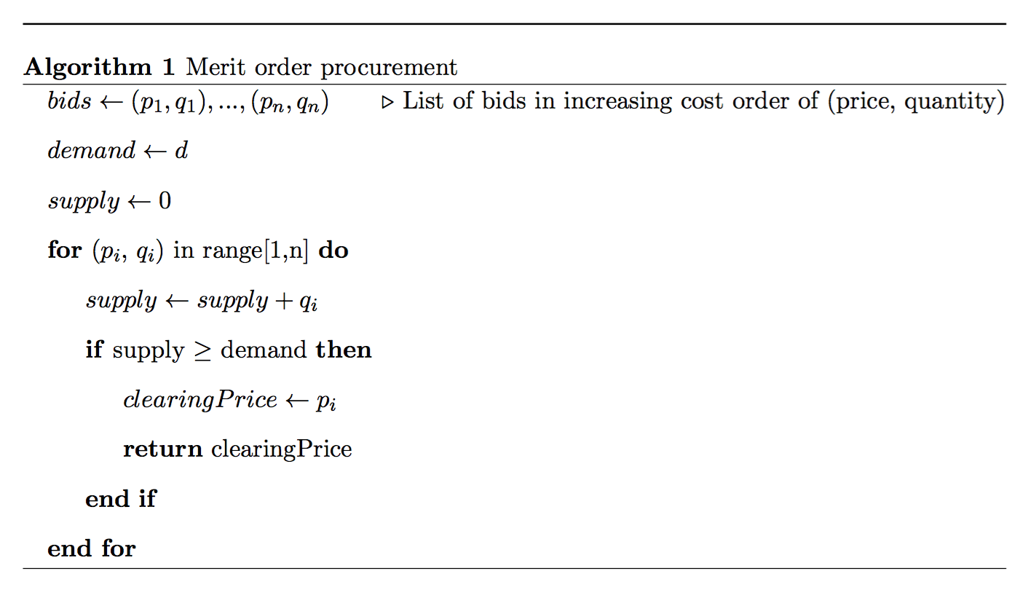
Key Terms:
Merit order
Notes:
Merit order procurement: purchase things in least cost order.
The majority of energy is purchased in this way, during different time periods.
Not important to know, but day-ahead market is the one I focus on, where hourly supply and demand is balanced according to bids sent in a day before the daily period starts.

Slide 6
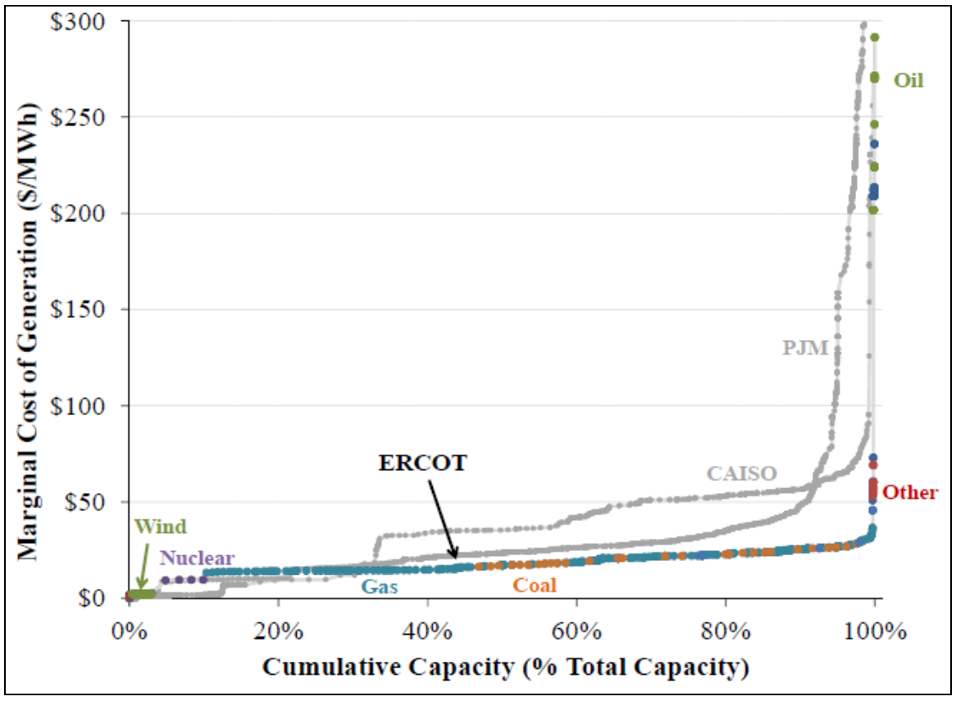
Key Terms:
Bid curve
Notes:
The bid curve is the representation of all the supply ordered by price.
Different resources exhibit different prices (place of coal and gas vary depending on the market, due to environmental regulations, regional price differences, etc.)

Slide 7
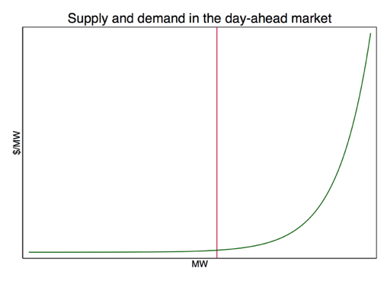
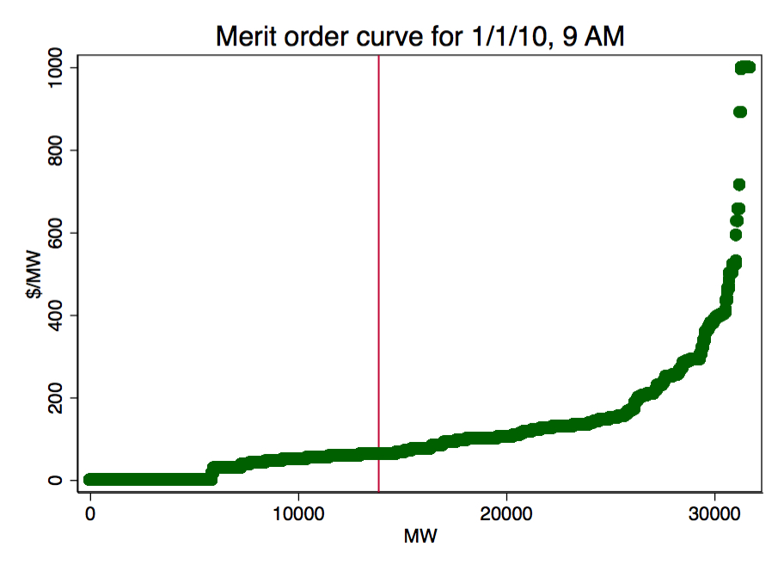
Supply and demand are constantly balanced to keep the lights on
Notes:
From my own data!

Slide 8
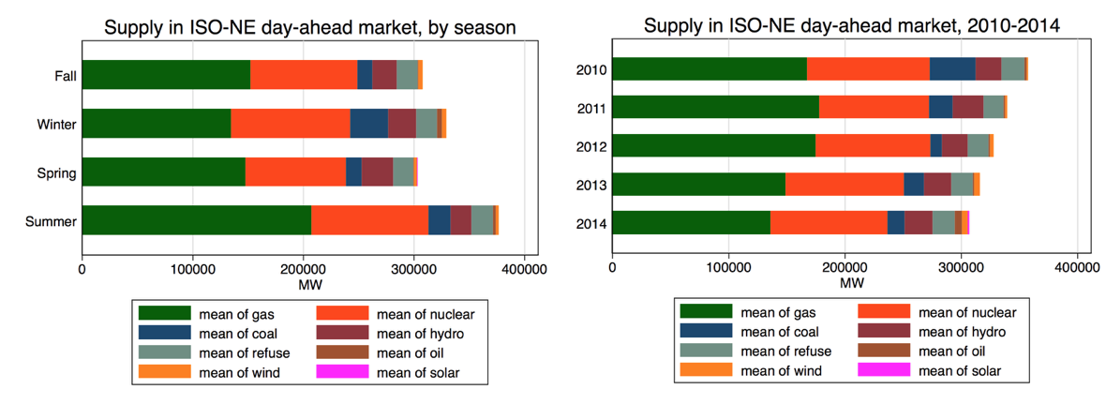
The supply mix varies seasonally, and has changed over the years

Slide 9
How have each of the resources on the resource mix historically impacted prices in New England’s electricity markets?

Slide 10
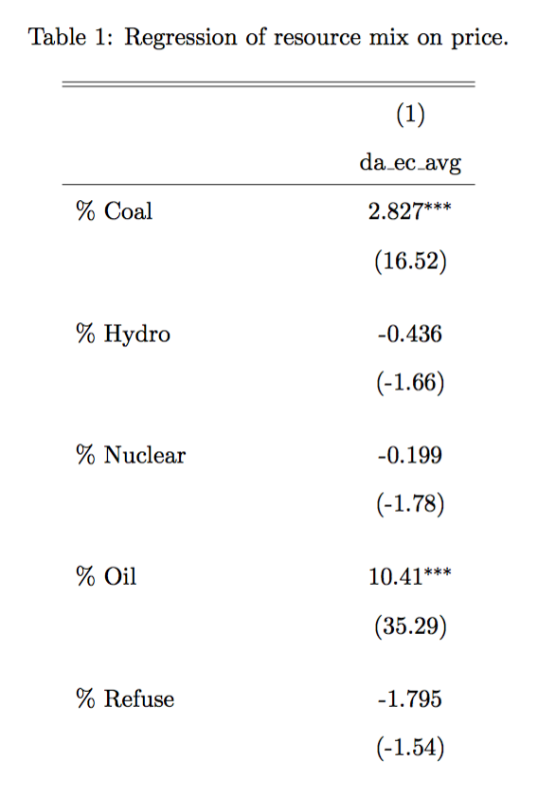
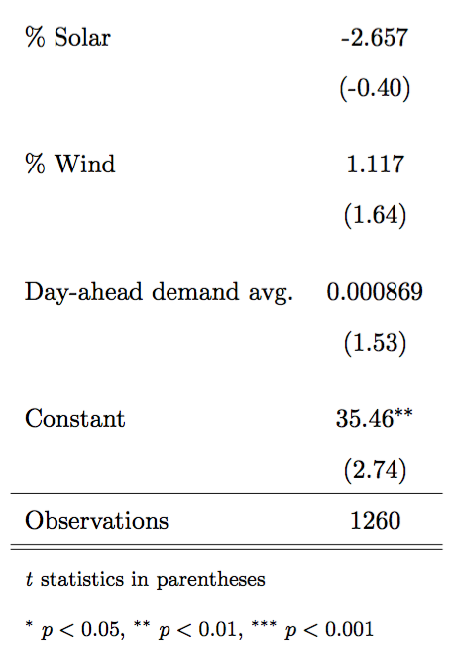
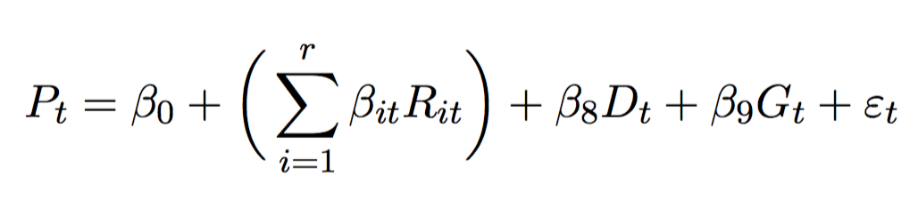
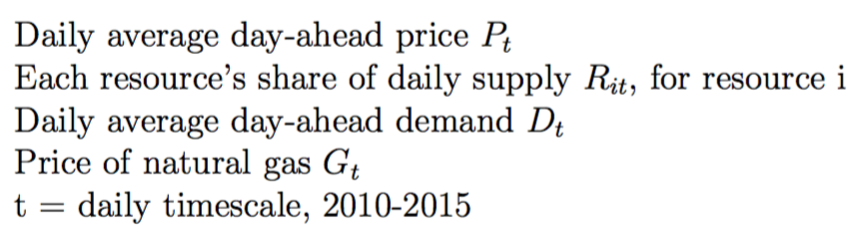
Regression:
resource mix on price

Slide 11
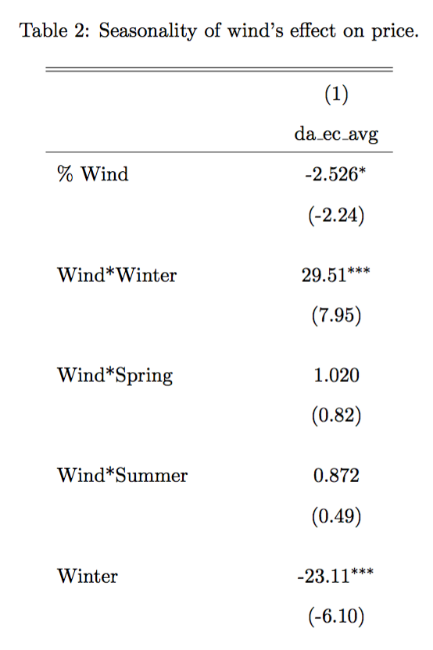
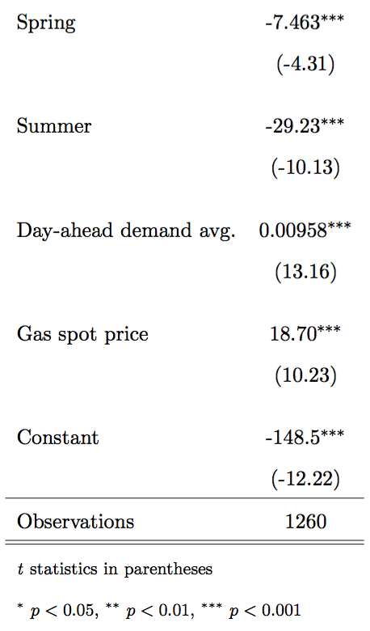
Seasonal variation
in effect of wind?
Notes:
One possible explanation may be that the merit order becomes violated more often as wind variability increases, due to the need to quickly fill in supply gaps that result from inaccurate wind forecasts; this would hypothetically be done by calling upon quick-starting but more expensive resources like oil or natural gas. However, the frequency at which these merit order violations occur is difficult to discern from our data.

Slide 12
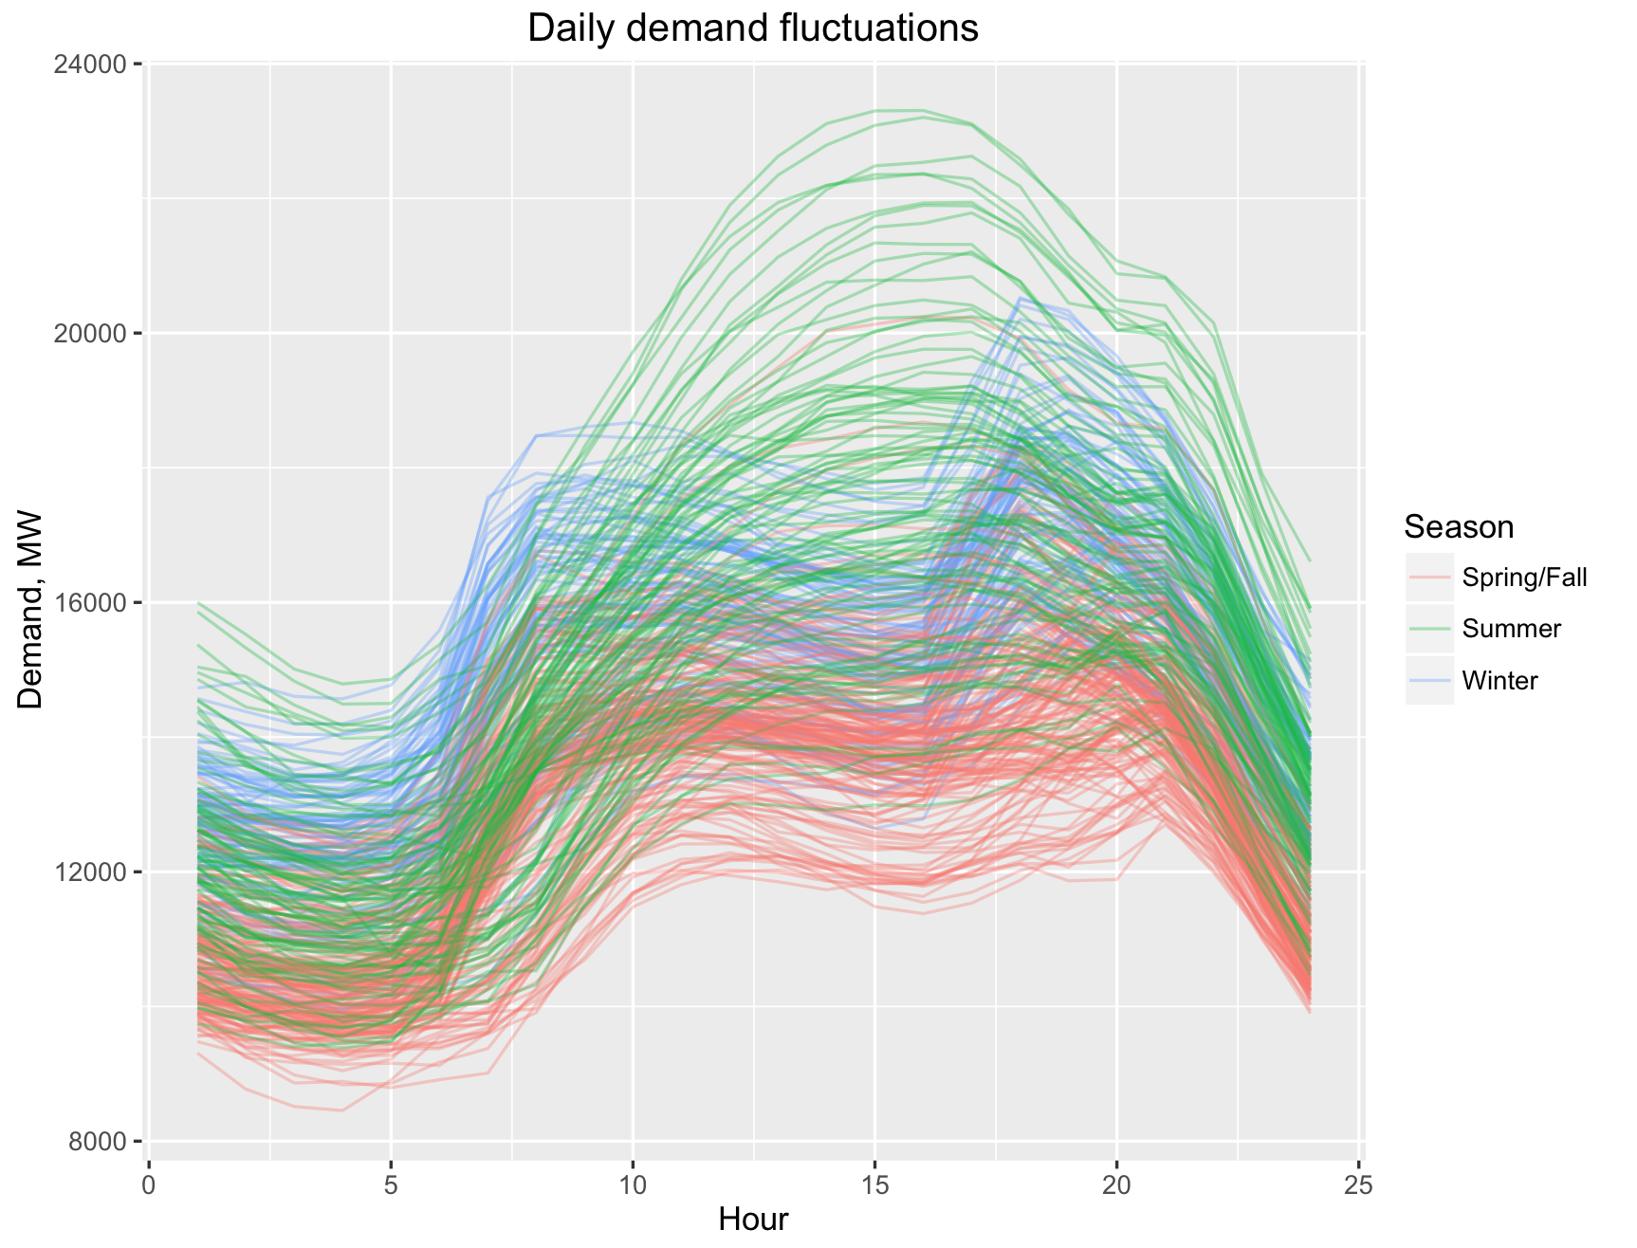
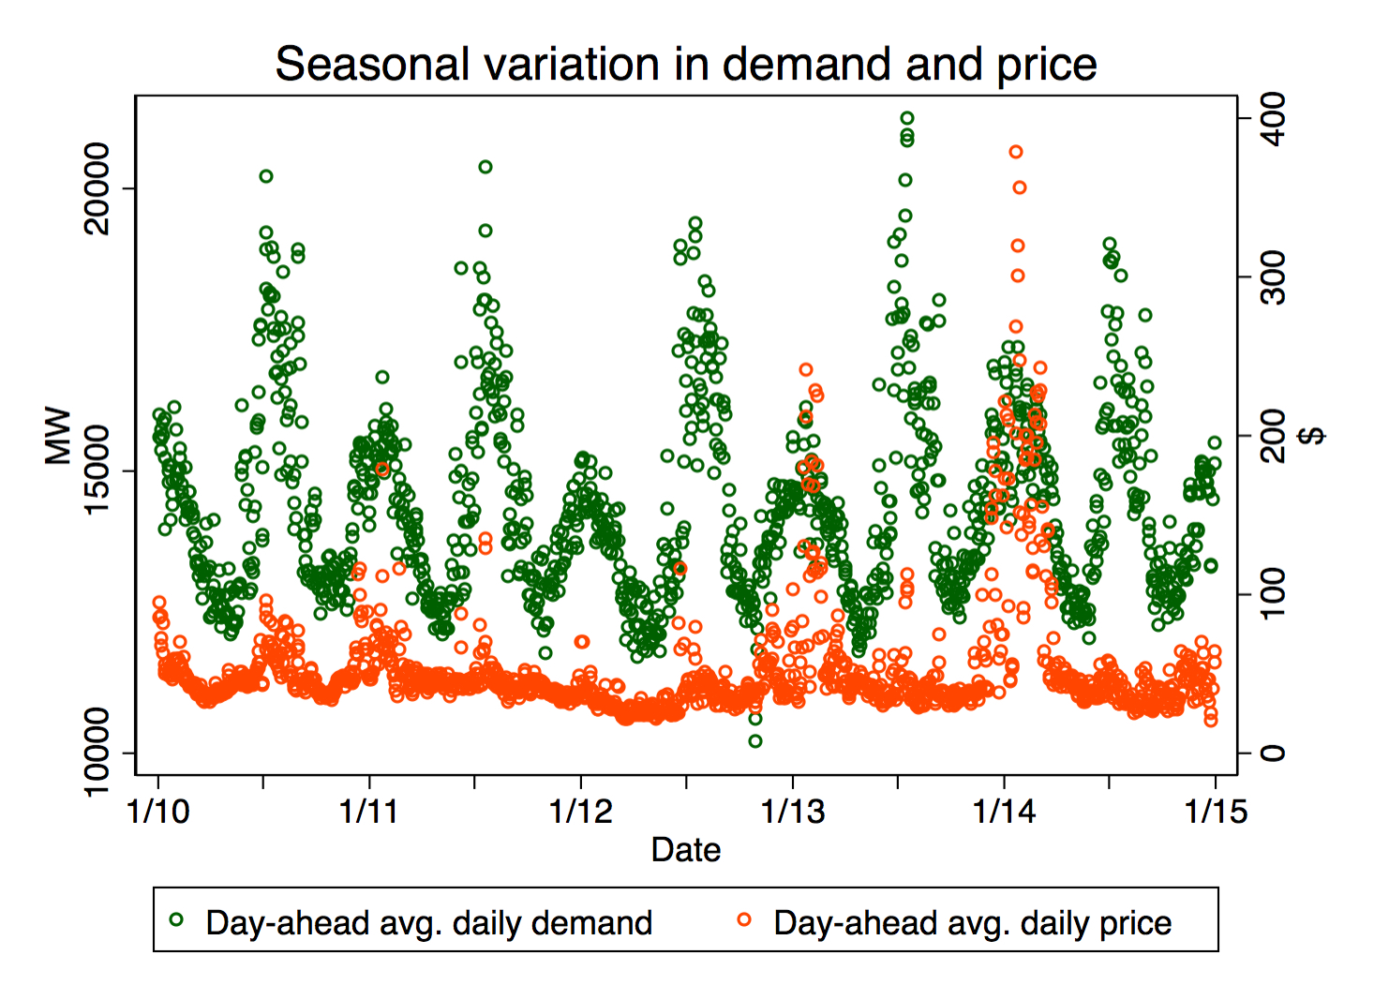
2. How do increased quantities of wind generation impact prices in New England’s electricity markets? How does this effect vary at different levels of electricity demand and by the composition of the resource mix?

Slide 13
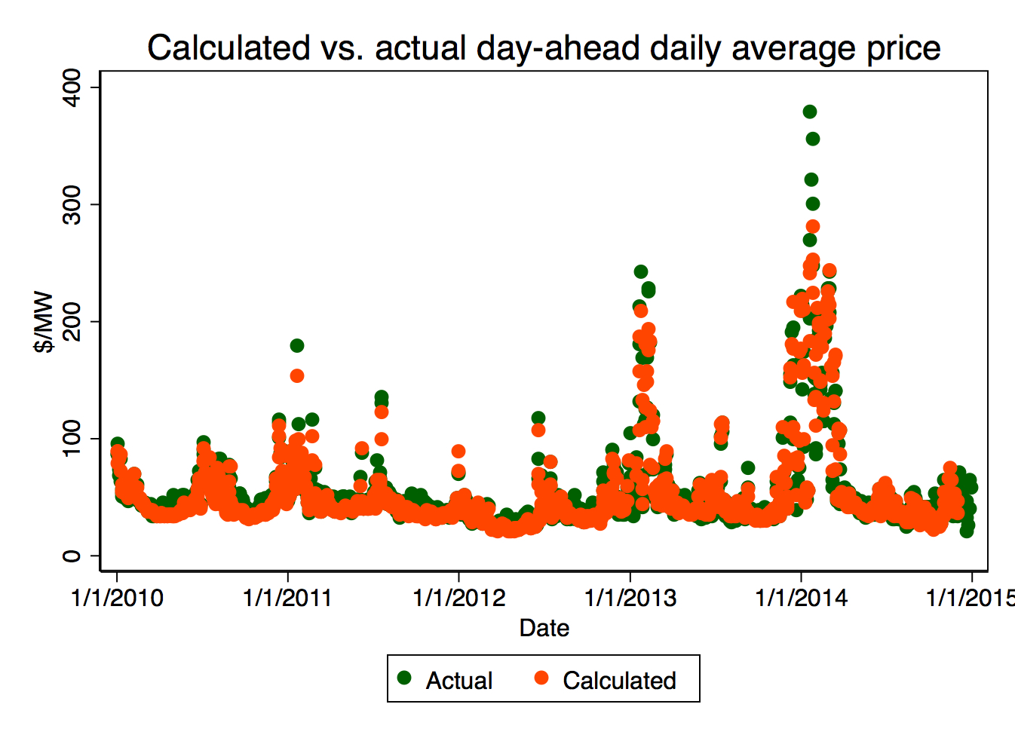
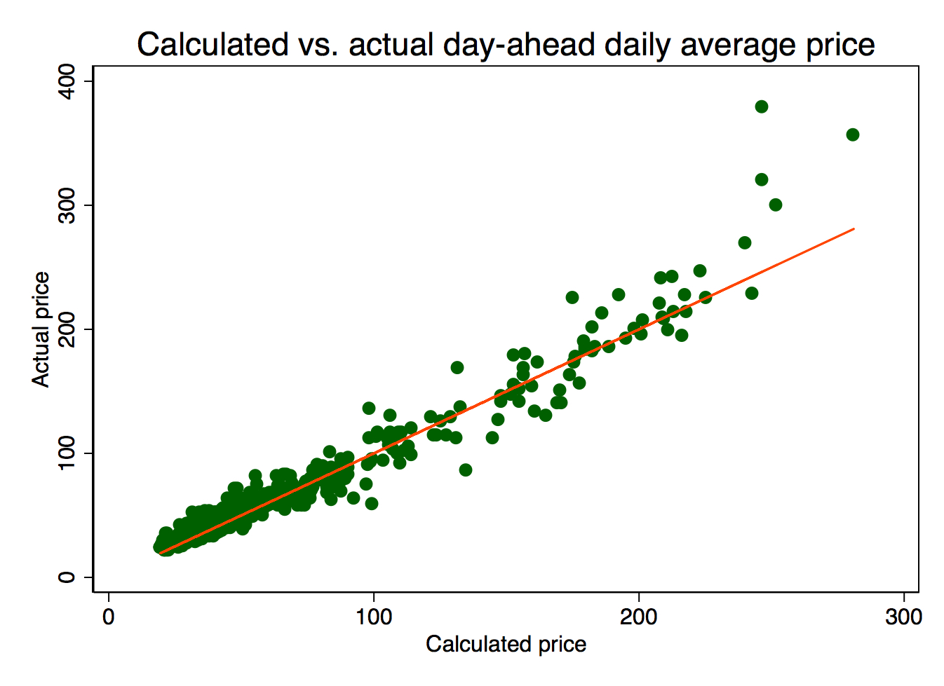
Merit order is sometimes overridden

Slide 14
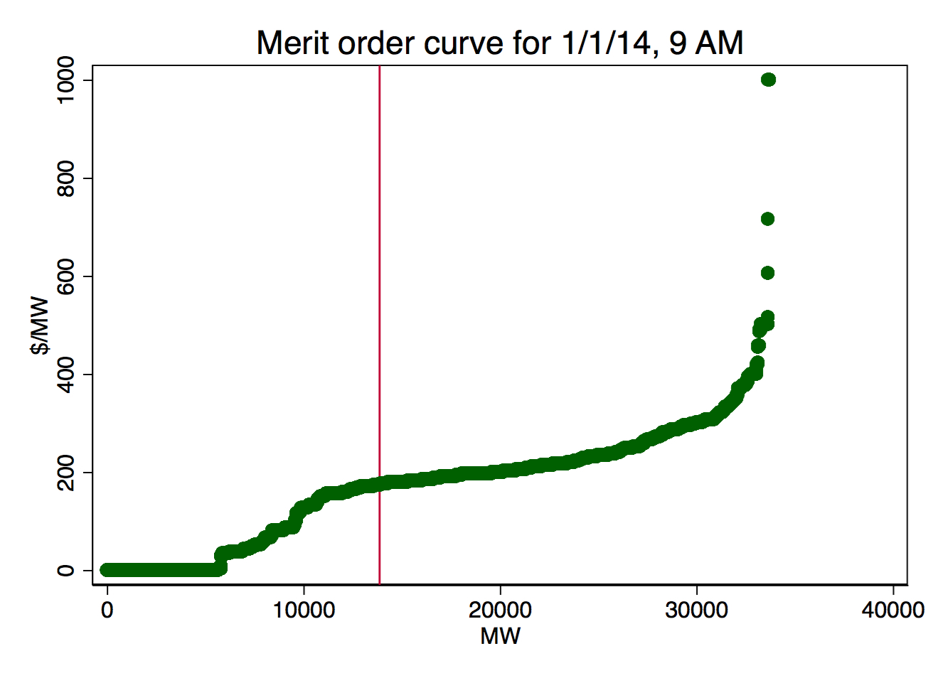
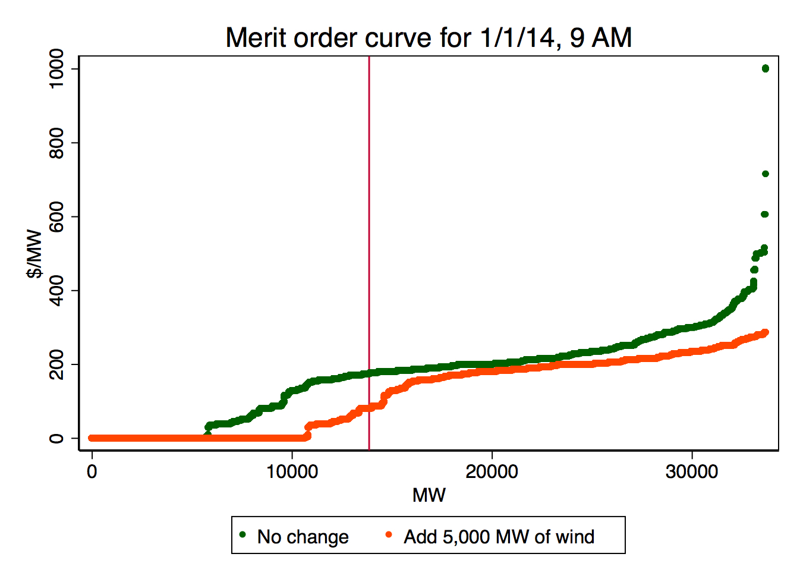
Adding wind to the bid curve shifts it to the right, equivalent to shifting demand to the left

Slide 15
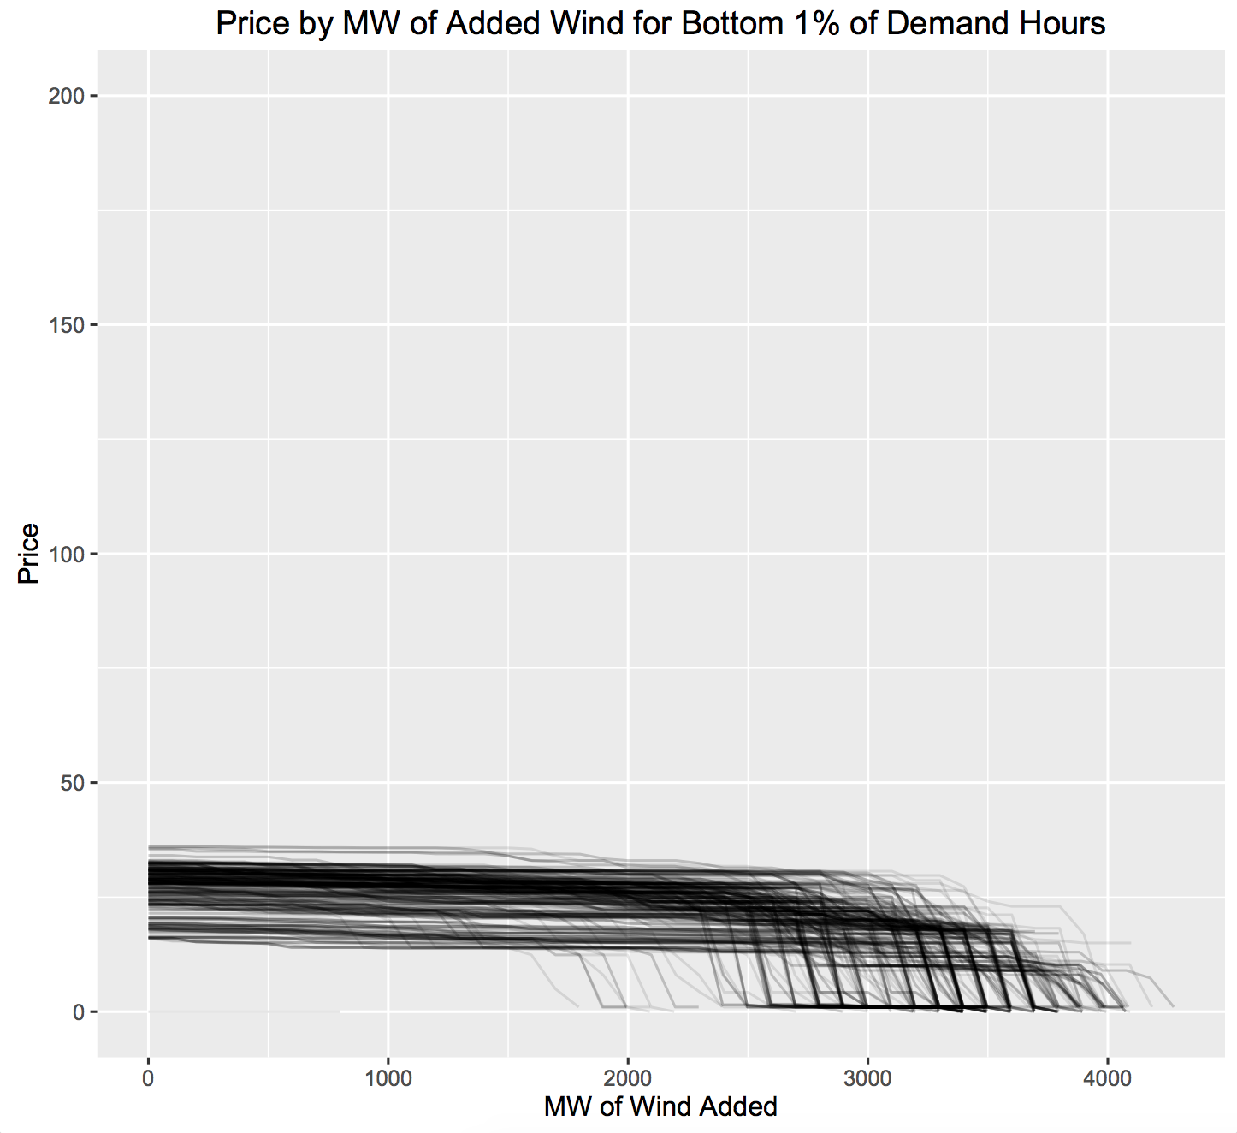
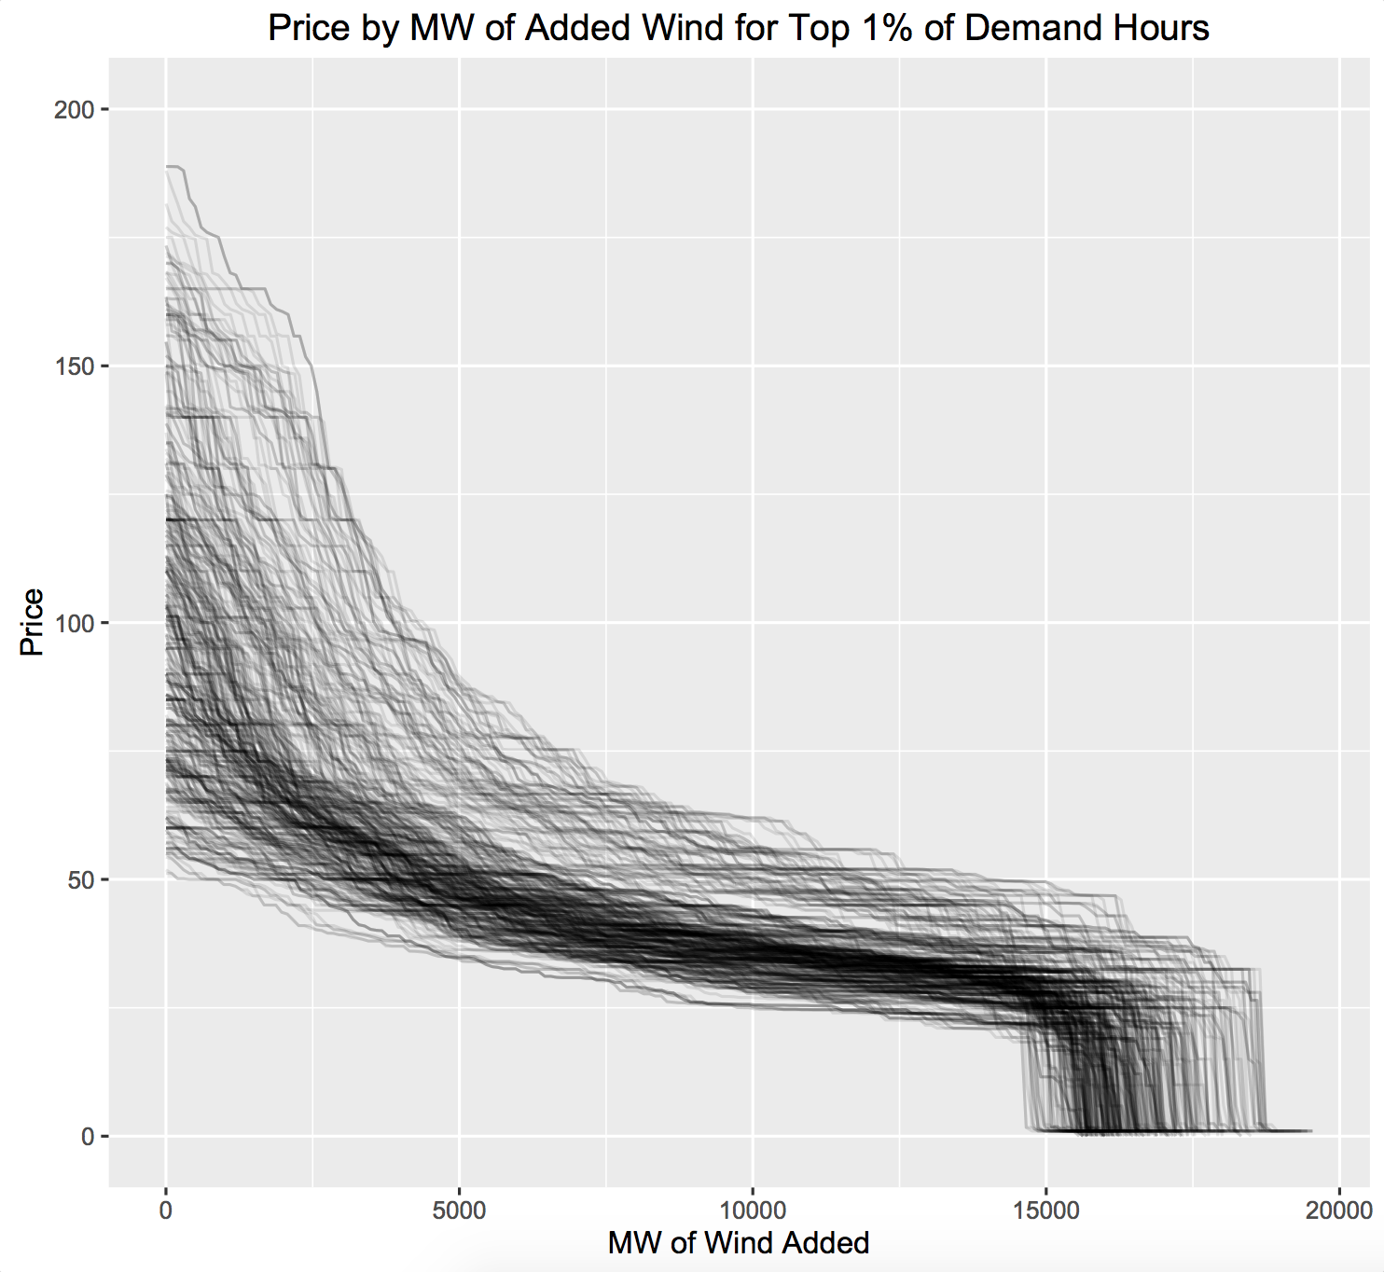
Change in price depends on demand level and the shape of the supply curve

Slide 16
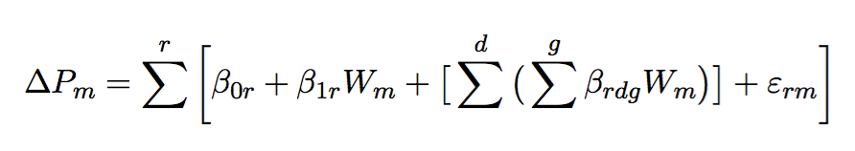
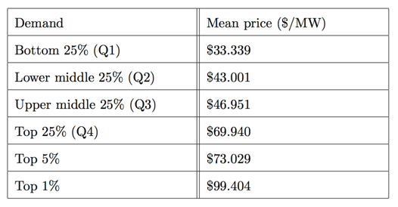
Regress on different levels of gas’ % of total supply and demand level, for 3 tiers of wind added

Slide 17
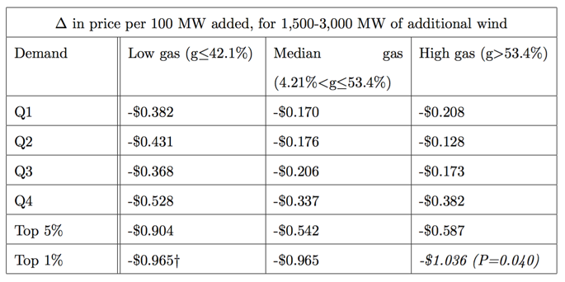
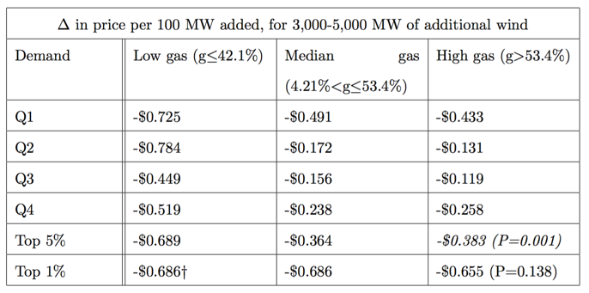
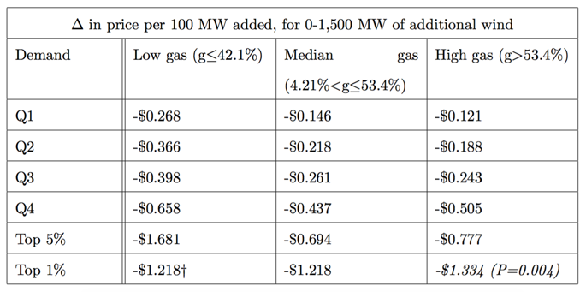
Prices change the most when the supply curve is steep, at high levels of demand and high shares of expensive generation.
Notes:
It’s really a mapping of the bid curve in reverse to look at the price changes

Slide 18
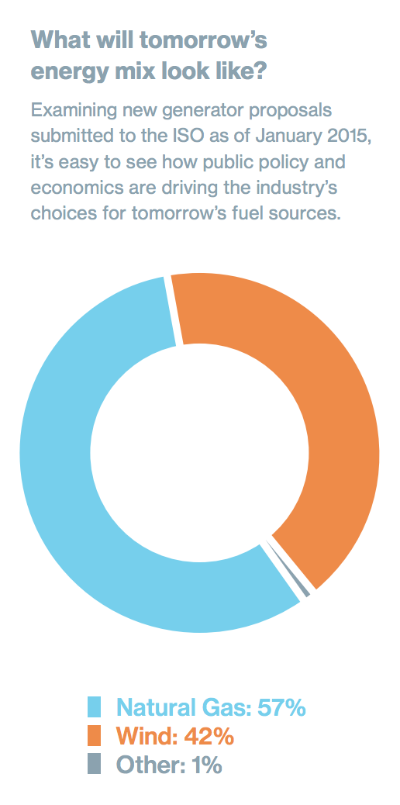
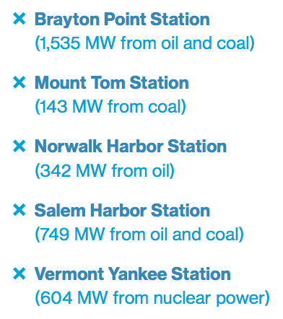
So what now?
A two-price, two-fuel regime?
Notes:
The changing of the resource mix directly influences the price of energy
Coal, oil, and nuclear exiting
Renewables, natural gas entering
High savings from current mix at high demand hours
Wind and natural gas → two main price segment regime, with some higher spikes
Must look at constraints of variability and

Slide 19
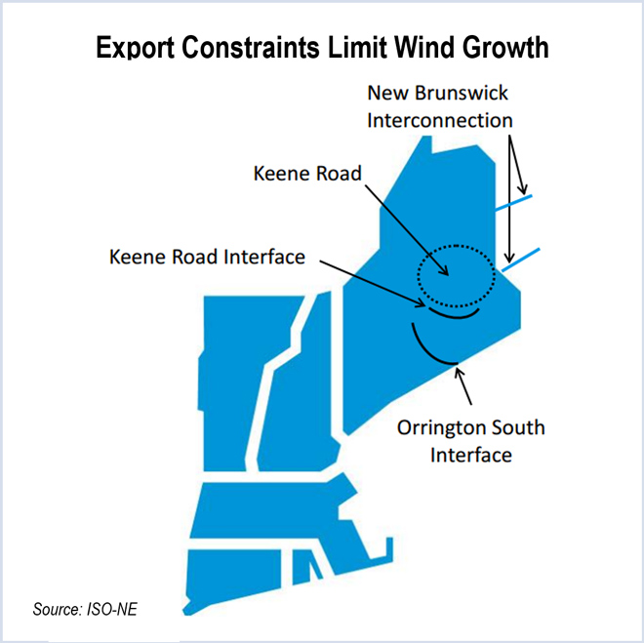
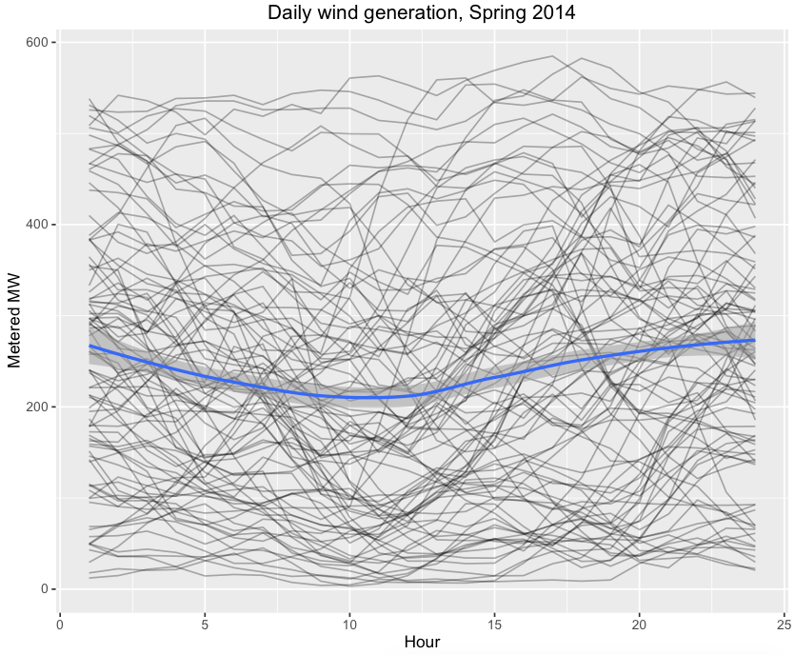
Considerations: transmission and variability

Slide 20
Acknowledgements
Anja Sautmann
Amy Greenwald
Sriniketh Nagavarapu
Dawn King
Christopher Geissler, ISO-NE
Jerry Elmer, Conservation Law Foundation
Jamie Fine, Environmental Defense Fund
All my friends and family!

